Slide 1
DETECTING PHISHING WEBSITES USING DATA MINING ALGOs
By :
Reshma Krishnakumar
Santhosh Bodla
Surbhi Dogra
Tanya Gupta
TEAM - 11

Slide 2
OBJECTIVE
Phishing is one of the most dangerous threats to your online accounts and data, because these kind of exploits hide behind the guise of being from a reputable company or person, and use elements of social engineering to make victims far more likely to fall for the scam.
In order to prevent the user from these practices we try to predict the data based on the URL of the website.
Analyze different classification algorithms and choose the best model based on the performance metrics like F1 score.

Slide 3
BACKGROUND
To give you an idea: 74% of U.S. organizations experienced a successful phishing attack in 2020, a 14% increase from 2019. According to the FBI, phishing is the most common type of cybercrime. In 2020, they saw 12 times more phishing attacks than in 2016.
COVID-19 phishing scams likely accelerated the increase in 2020. The pandemic introduced new opportunities for scammers, and some estimate that drove up cybercrime by 600%!

Slide 4
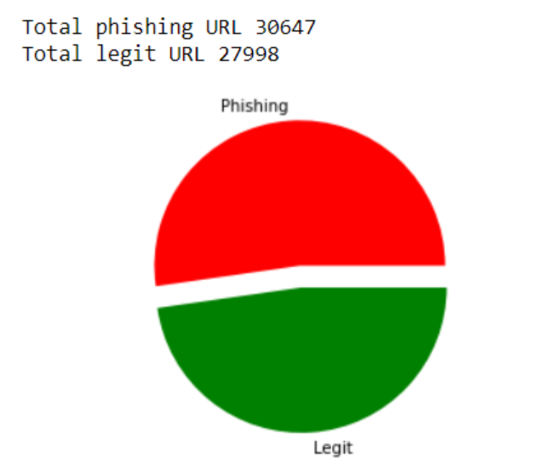
DATA SET DETAILS
Total number of instances: 58,645
Number of non-phishing instances: 27,998
Number of phishing instances: 30,647 Total
Number of features: 111
Reason to choose: More Balanced

Slide 5
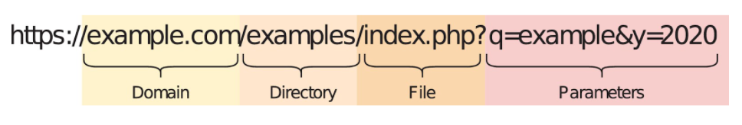
DATA SET DESCRIPTION
Our Data set is divided into 6 Different parts as
Attributes based on the whole URL properties
Attributes based on the domain properties
Attributes based on the URL directory properties
Attributes based on the URL file properties
Attributes based on the URL parameter properties
Attributes based on the URL resolving data and external metrics

Slide 6
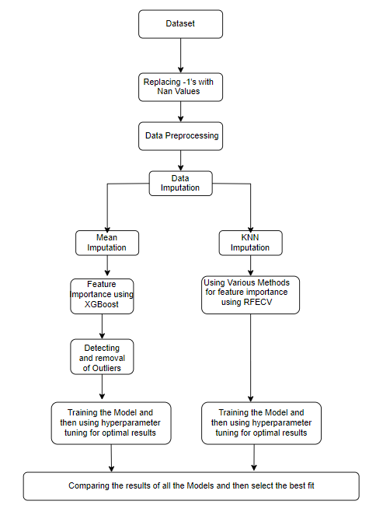
WORKFLOW

Slide 7
DATA PRE-PROCESSING
Dropping all the Columns whose that have the same value in all samples
Delete Duplicate rows (if any)
Convert the -1’s to NAN values
Dropping the columns having value -1 in more than 80% of the cells

Slide 8
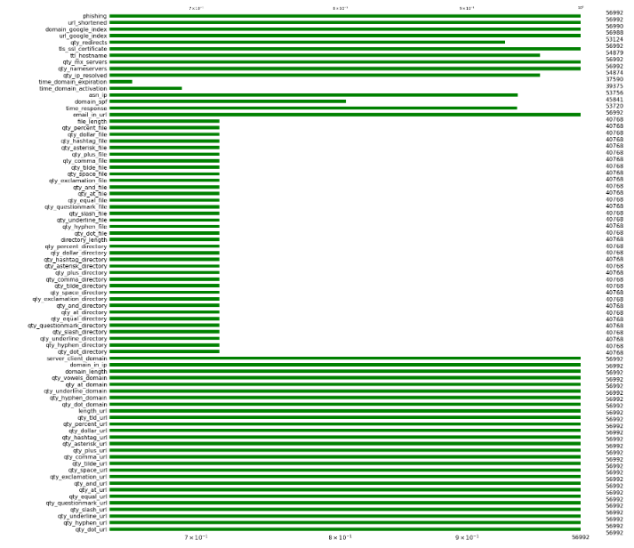
VISUALIZATION
Visualize the Missing data using a bar chart from missingo library.

Slide 9
METHODOLOGIES - MEAN IMPUTED DATA
Feature Importance using XGBoost
Hyper Parameter Tuning of XGBoost
Detection and Removal of Outliers
Visualization and Analysis of data
Model Training by leveraging Hyperparameter tuning
for Obtaining Optimal Results

Slide 10
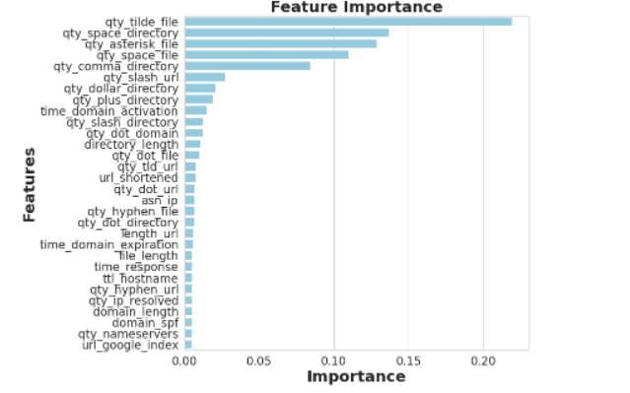
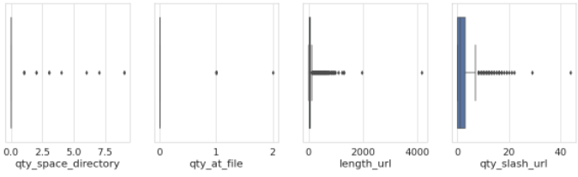
MEAN IMPUTED DATA - FEATURE IMPORTANCE AND OUTLIERS
Finding out the most important features which contribute to detecting phishing
Visualizing Outliers for certain features

Slide 11
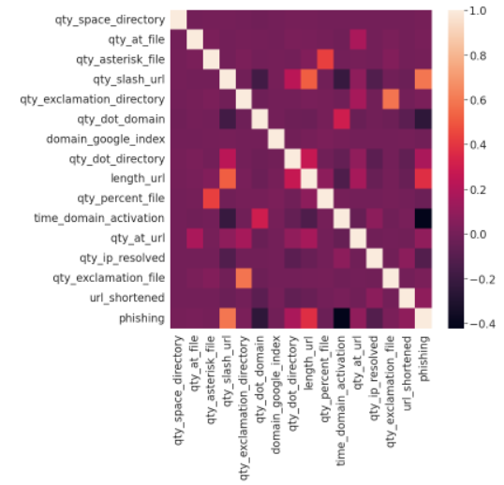
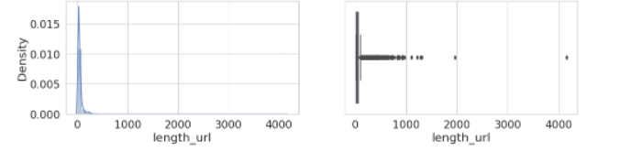
MEAN IMPUTED DATA
Post Removal of Outliers using IQR
Correlation between Phishing and other features

Slide 12
RESULTS OBTAINED MEAN IMPUTED DATA
Classifier | Accuracy
Logistic Regression | 99.94% (Overfitting)
KNN Classifier | 94.42%

Slide 13
METHODOLOGIES - KNN IMPUTED DATA
Data Analysis on Categorical Features
Correlation between dependent Feature and Independent feature
Feature Selection using Recursive feature elimination with cross-validation
Model Training by leveraging Hyperparameter tuning
for Obtaining Optimal Results

Slide 14
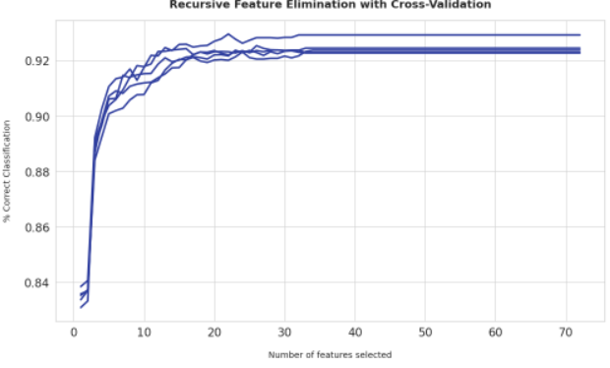
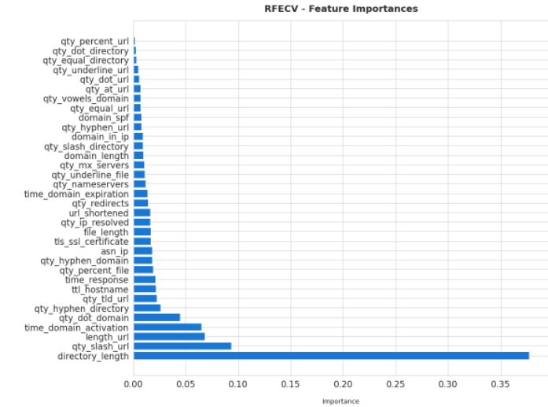
KNN IMPUTED DATA
Accuracy vs Features selected
Feature Importance using RFECV
We can observe from the above plot as no of selected features increase our accuracy initially increased and then saturated. After approximately 30 selected features the accuracy is flattened.
20XX
‹#›

Slide 15
RESULTS OBTAINED FOR KNN IMPUTED DATA
Classifier | Accuracy
Logistic Regression using hyperparameter tuning | 89.07%
XGBoost hyperparameter tuning | 92.77%
RandomForest hyperparameter tuning | 95.63%
‹#›

Slide 16
CONCLUSION
As Mean Imputation doesn’t incorporate relation among the features, despite dropping the outliers
Logistic regression classifier was overfitting with accuracy of 99%
And, KNN Classifier gave accuracy of 95.34%
To overcome the issue encountered with Mean Imputation, we performed KNN imputation
Logistic regression gave accuracy of 89.07%(overcame overfitting)
Random Forest Classifier gave accuracy of 94.63%
XGB Classifier gave accuracy of 92.77%
Therefore, we achieved best accuracy using KNN imputation.
It can be observed that the important features for both KNN imputed analysis and Mean imputed analysis is based on the attributes relating to URL and External services.

Slide 17
THANK YOU

